Slide 1




Patrick Flynn SQL Server DBA Link Group Australia Group
MCM – SQL Server 2008
MCSM – Data Platform
Production DBA for 10+ years.
Regular Speaker at SQL Saturday and other community events in Asia Pacific region
All Presentations available at:
https://github.com/sqllensman/Presentations
dps2018@sqllensman.com
@sqllensman
Patrick Flynn

Slide 2
Agenda:
PowerShell – Quick Recap
Advanced Functions
dbatools
Pester and other Modules
Demos

Slide 3

Why powerSHELL?

Slide 4
Advanced Functions:
[CmdletBinding()]
Verbose
ErrorAction
WhatIf
Confirm

Slide 5
DBATOOLS.io

Slide 6

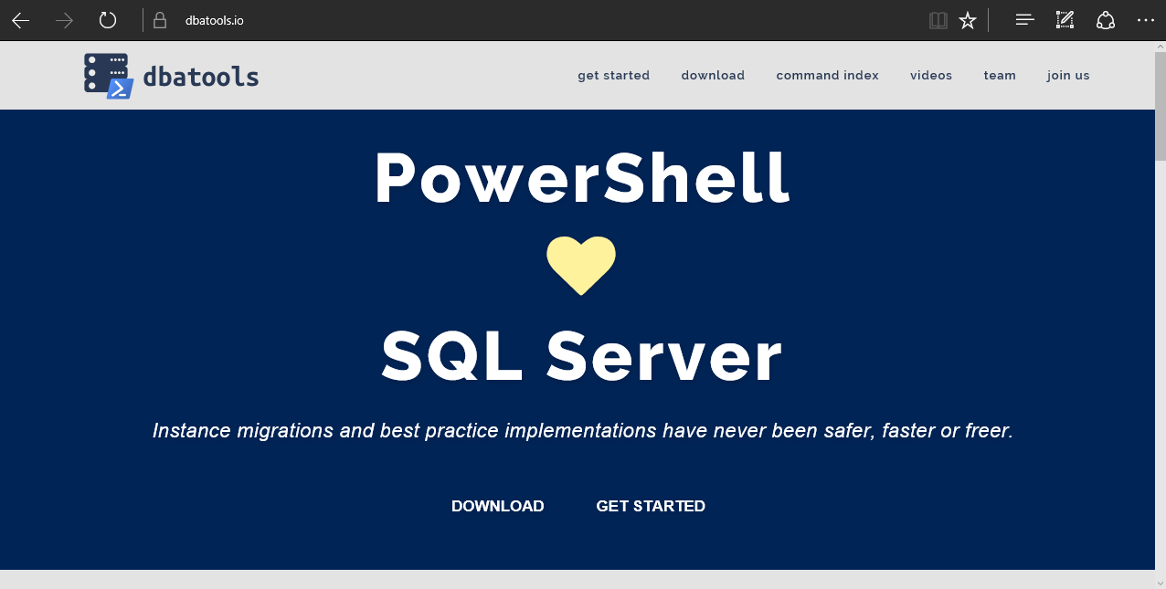
dbatools
Notes:
Community project, initially started out as Start-SqlMigration but has grown into a DBA’s best friend. dbatools currently sports 500+ commands.
How many of you have heard of dbatools? How many of you have used it? How many knew it was born in Belgium? :D

Slide 8
What is Pester:
Test Runner for PowerShell
A Unit Testing Framework
An Infrastructure Testing Framework
Comes pre-installed with Windows.
Notes:
https://www.youtube.com/watch?v=lNCR5yLSwi0 -- Test your Powershell with Pester and PSScriptAnalyzer
“Untested Code is Broken Code”
Infrastructure Testing with Pester - https://www.youtube.com/watch?v=zSEK74_fsLw
Pester is a unit-testing framework for PowerShell, and perhaps the first open-source software product that ships with Windows itself!
Author Adam Bertram will walk you through the Pester philosophy, syntax, and numerous real-world examples in this "Agile-published" book.
The Pester Book
https://leanpub.com/creatinghtmlreportsinwindowspowershell
https://leanpub.com/powershell-scripting-toolmaking
https://leanpub.com/pesterbook

Slide 9
Other Useful Modules:
PSFramework
ImportExcel
ReportHTML
PoshRSJob.
Notes:
https://www.youtube.com/watch?v=lNCR5yLSwi0 -- Test your Powershell with Pester and PSScriptAnalyzer
“Untested Code is Broken Code”
Infrastructure Testing with Pester - https://www.youtube.com/watch?v=zSEK74_fsLw
Pester is a unit-testing framework for PowerShell, and perhaps the first open-source software product that ships with Windows itself!
Author Adam Bertram will walk you through the Pester philosophy, syntax, and numerous real-world examples in this "Agile-published" book.
The Pester Book
https://leanpub.com/creatinghtmlreportsinwindowspowershell
https://leanpub.com/powershell-scripting-toolmaking
https://leanpub.com/pesterbook

Slide 10


Slide 11
Questions?
?
?
?
?
?
?
?
?
?
?
?
?
?
?
?
?

Slide 12
Powershell Resources
PowerShell for SQL Data Professionals
https://mva.microsoft.com/en-US/training-courses/powershell-for-sql-data-professionals-16532?l=XgA5w0PgC_8805121157
PASS Powershell Virtual Chapter
http://powershell.sqlpass.org/
PASS Recordings
http://www.pass.org/Learning/Recordings/Listing.aspx?category=webinars24Hours
Manage SQL Server in Linux Containers using dbatools
https://www.powershellgallery.com/packages/PoshRSJob/1.7.3.9

Slide 13
Powershell Resources
PoshRSJob
https://www.powershellgallery.com/packages/PoshRSJob/1.7.3.9
https://learn-powershell.net/2015/03/31/introducing-poshrsjob-as-an-alternative-to-powershell-jobs
PSFramework
http://psframework.org/
ImportExcel
https://4sysops.com/archives/read-and-write-excel-spreadsheets-with-the-importexcel-powershell-module/
ReportHTML
http://www.azurefieldnotes.com/2016/08/04/powershellhtmlreportingpart1/

Slide 14
dbatools
Extensive documentation within each command Get-Help Start-DbaMigration –Detailed
Extensive documentation on dbatools.io
dbatools.io/Start-DbaMigration
dbatools.io/Repair-DbaOrphanUser
Some commands have videos
dbatools.io/youtube

